Slide 1
Substrate removal analysis for cross prepared samples
By Daniel Arnoldi ID# 113251407

Slide 2
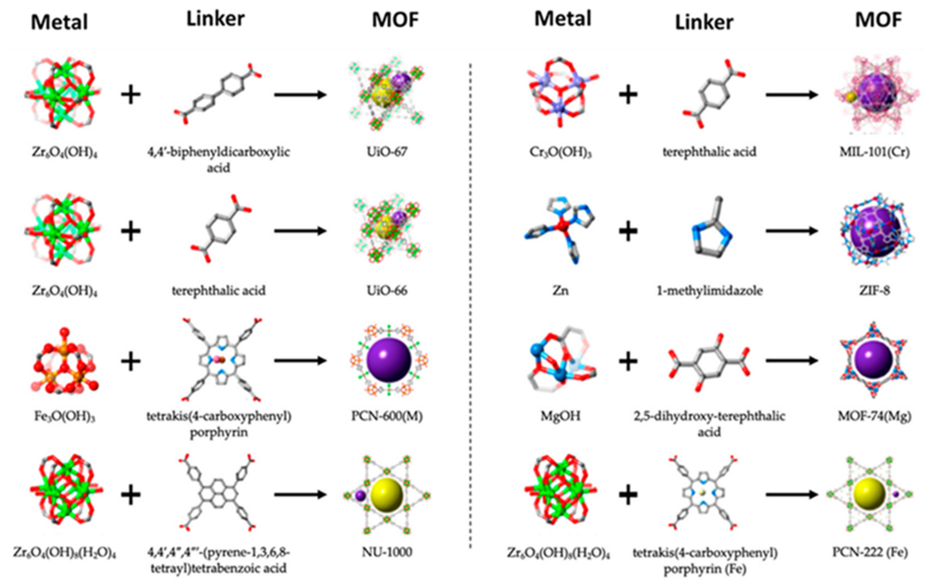
Introduction MOF based materials
MOFs or metal organic frameworks are a nanomaterial composed of a metal node with an organic linker.
Pictured to the side they are an flexible material with a variety of highly useful features, including but not limited to:
High surface area
Easy formation and chemical tunability
Small pore and aperture size

Slide 3
Background- variable substrates
Substrates also play an important role in the formation process, and relate heavily to the applications of a MOF traditionally mofs can be grown on a variety of substrates through one of three methods.
Anchored growth on a substance(Si wafers, Polypropylene fabric): Through methods like ALD surfaces can be prepared creating either an ideal surface for the growth of MOFs or including one of the necessary materials on the surface such as a metal oxide coating being consumed and contributing the metal nodes
Catalyzed growth on a surface(Carbon paper, gold coated Si Wafers): through the use of methods such as current driven synthesis which applies a current at a surface or the seeding of nucleation points crystals can be encouraged to grow connected to a surface as well as in solution around them
Post synthetic integration(Polymeric materials): MOFs if grown in a powder form can be integrated into a variety of materials such as packing materials for catalytic cells or mixed into polymeric membranes to form mixed matrix membranes for applications like separations

Slide 4
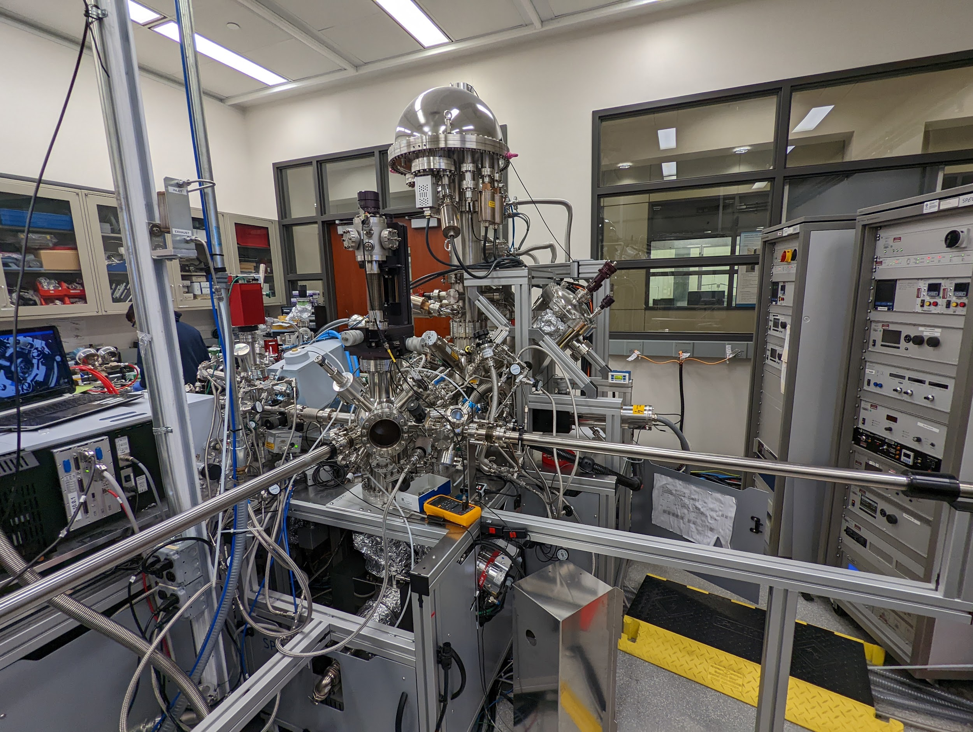
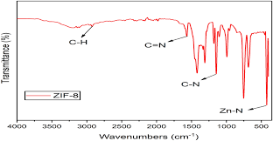
Characterization technique - FTIR and IIRAS
When examining mofs there are several characterization techniques of interest, but one of the primary examines chemical bonding.
FTIR and IIRAS are spectroscopy techniques which use light to examine what kinds of bonds are present in a material.
Variable frequency light hits a material and different bonds will absorb light at different wavelengths. Allowing you to get an idea of what bonds or functional groups exist in a material.
This is extremely useful when it comes to mof. Allowing us to verify the formation of our materials of interest
We usually do this in two forms. FTIR or Fourier Transform Infrared Spectroscopy in which light is shown through a sample or IRRAS, Infrared Reflection Absorption Spectroscopy which is a highly surface sensitive spectroscopy technique

Slide 5
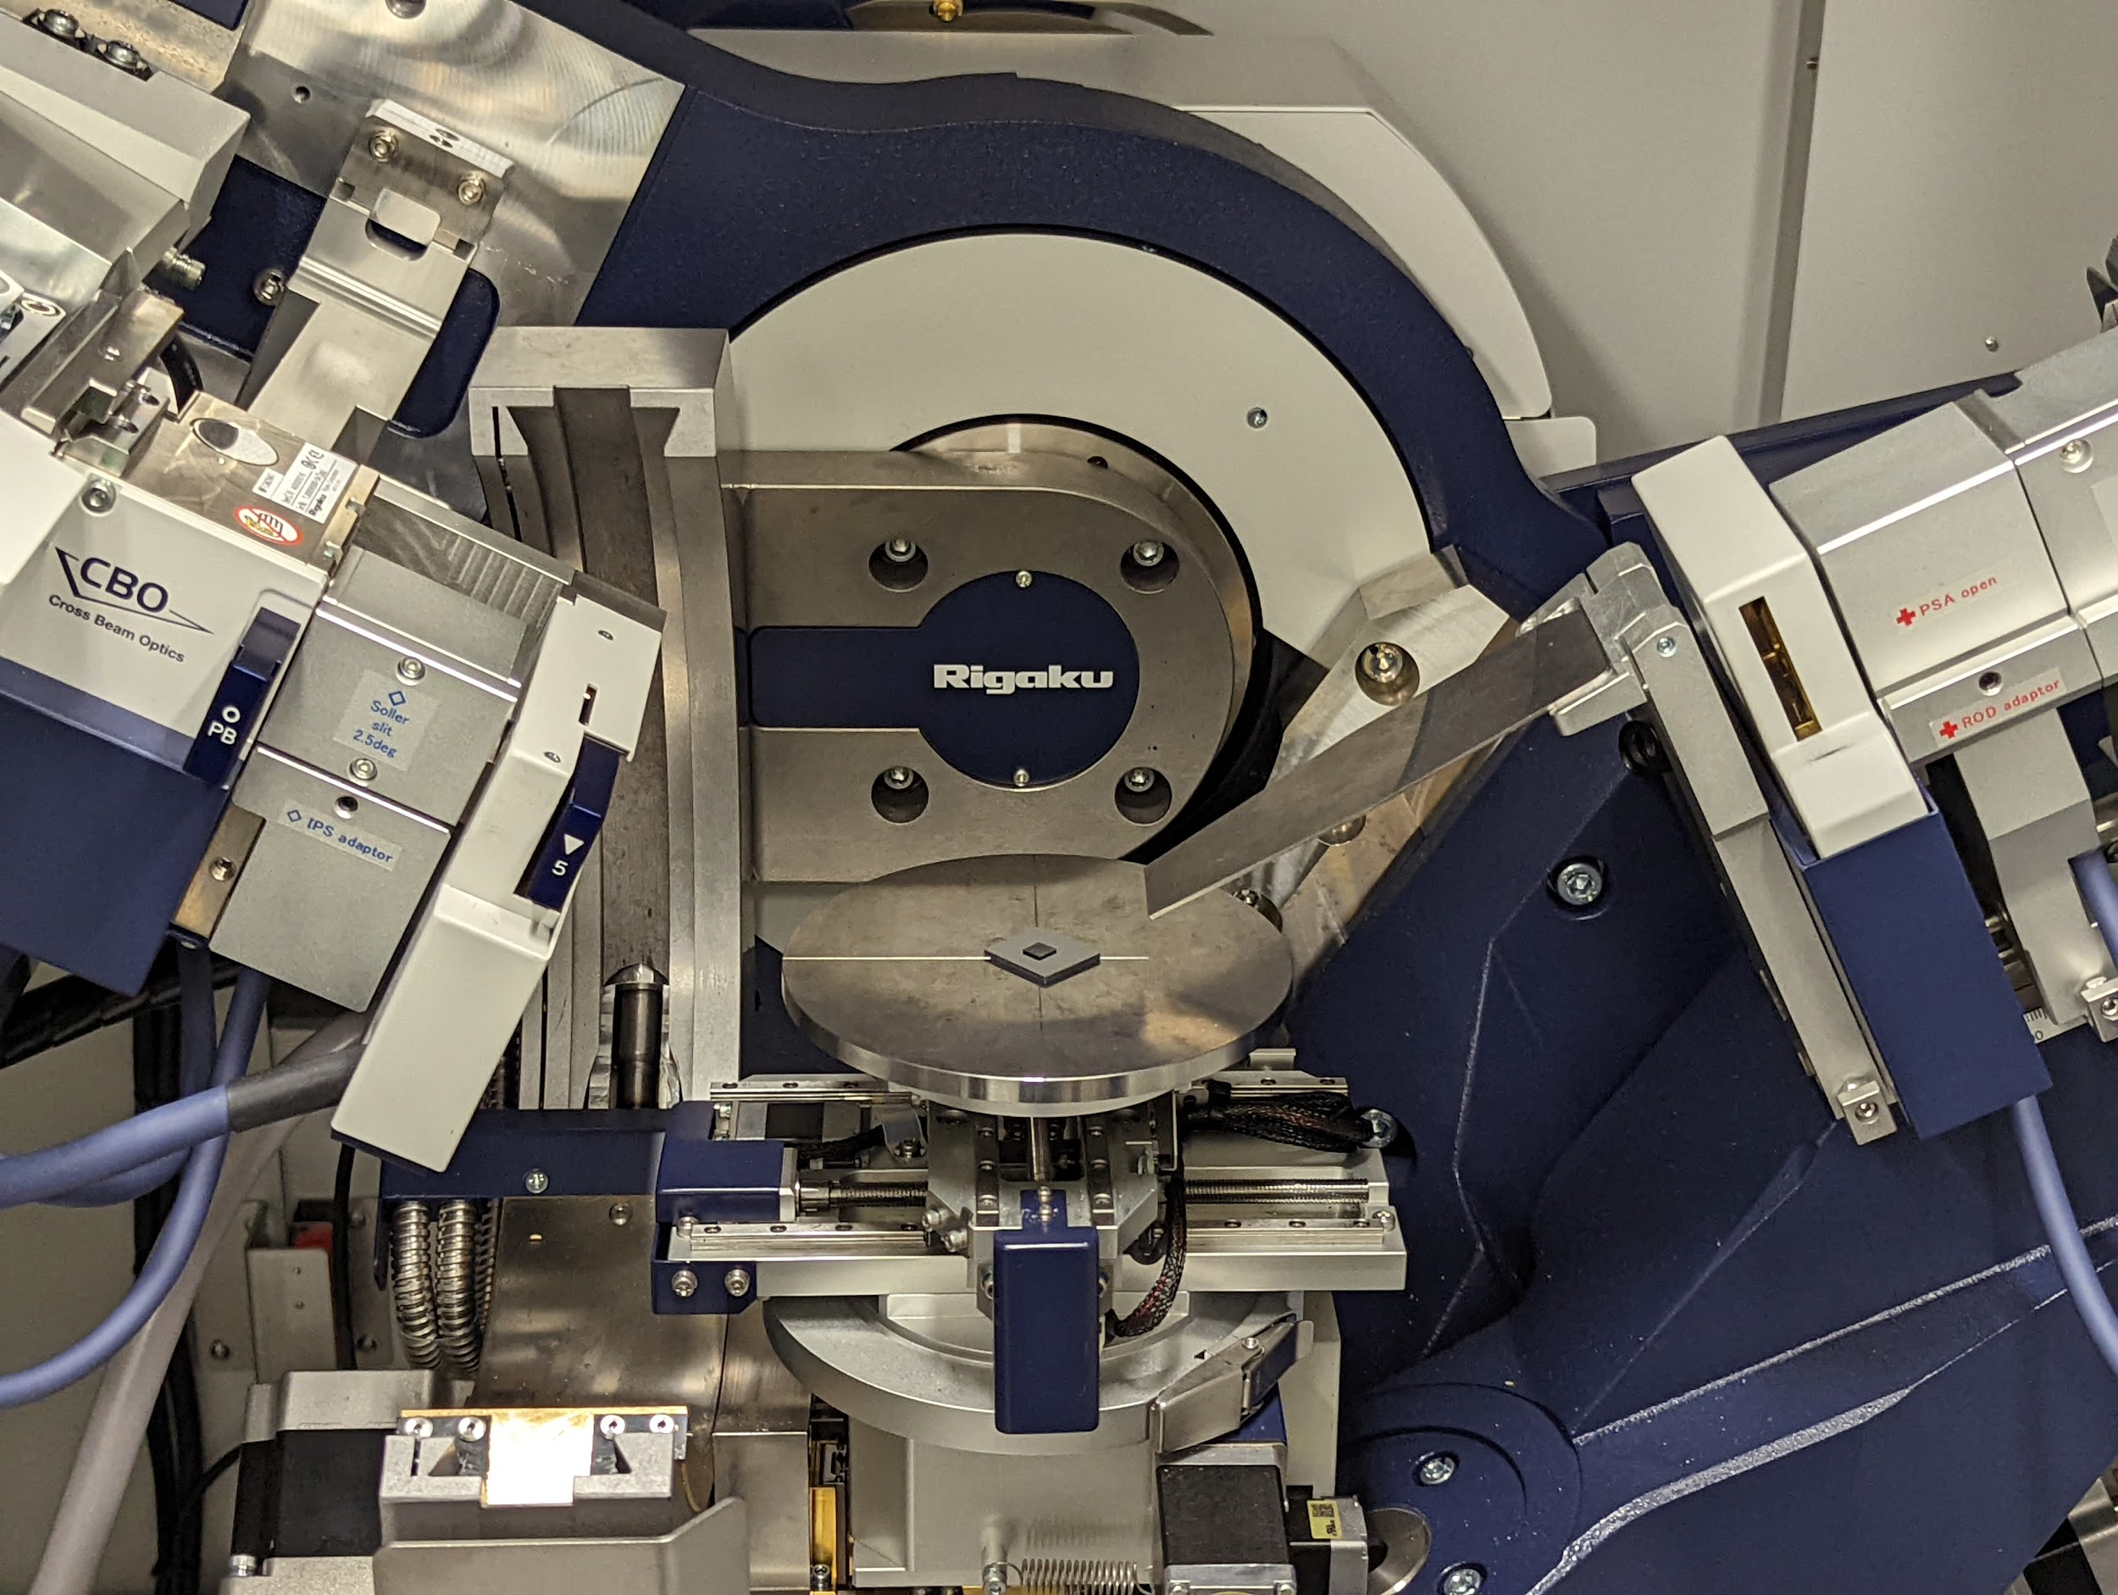
Characterization technique - XRD
XRD is a technique used for identifying the crystal phases in a material. By analysing how X rays are scattered upon hitting the surface of a material it is able to identify the crystal planes and structure of a material and whether it is crystalline or amorphous. Or any major defects or deviation in crystallography.

Slide 6
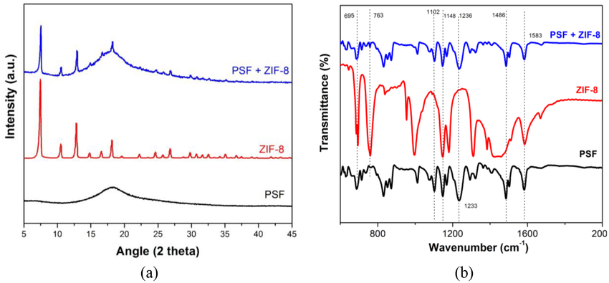
Methodology - substrate removal
While these MOF based materials have a variety of applications, the fact we are working with a variety of different substrates poses its own challenges. For XRD and FTIR substrates will have their own signals which we expect to find traces of in our results. If we want to compare samples across different substrates we need to be able to isolate and remove the background

Slide 7
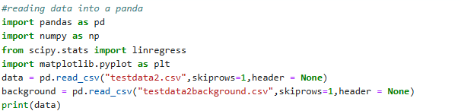
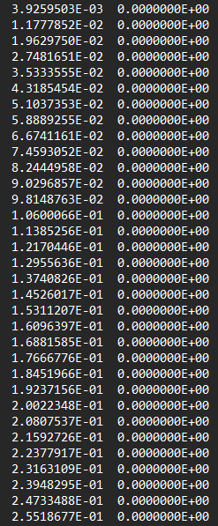
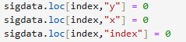
Code - File types and Panda handling
The primary kind of file produced by XRD and FTIR is in the form of CSV or comma separated values. Lists of individual points with little additional information usually at the top in the form of strings.
This project uses panda data structures for storage as shown. By including the skiprow keyword it allows us to skip any additional information as needed.
For simplicities sake this data is simply indexed with 0 and 1 for x and y data. But later in the program the headers “x” “y” and “index” are used. Index has been included for tracking since the number of items in an array can at times shift.

Slide 8
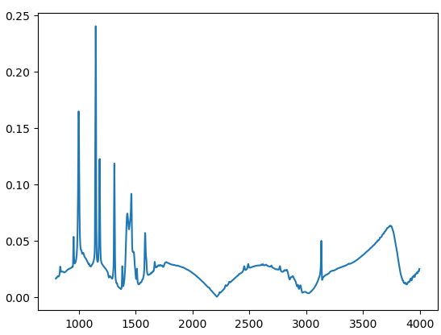
Methodology - Peak finding
One important task for both techniques is being able to find where peaks occur. Both XRD and IR spectrums will have a variety of peaks each of which will contain information about your sample.
So being able to find the precise location of peaks for a given dataset is highly important but a challenge.How do you find peaks when looking at a data set full of individual data?
This graph represents FTIR data for ZIF-8 with simulated noise
This can be achieved by point to point slope analysis. With a few additional variables. By comparing each point to the next in the sequence then at times series of points we can find where the function trends up. Altho there are a few variables to consider.
Minimum slope: what is the minimum slope you
Range: what range of x values are you looking at
Minimum value: what values do you consider insignificant
Direction: based on your baseline do you care about peaks or valleys

Slide 9
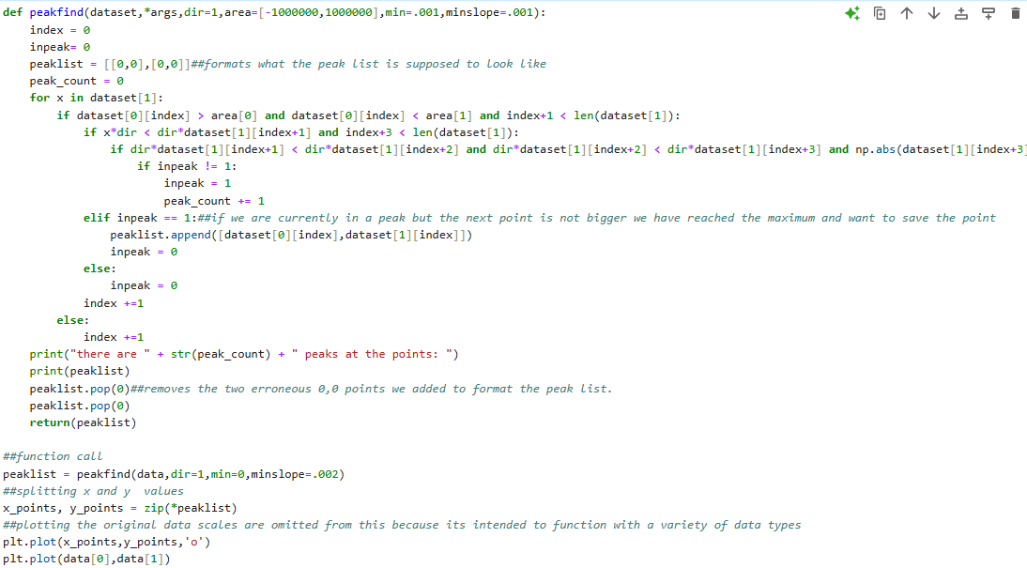
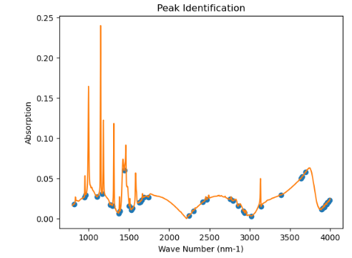
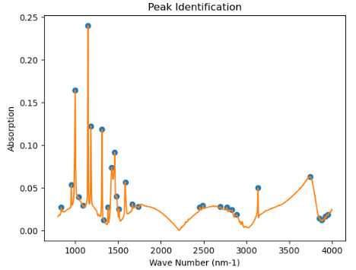
Code - Peak finding
The code is broken down into 3 sections, set up, analysis and reporting.
Set up involves formatting peaklist as a 2D list of paired values.
Analysis scans the data identifying when there is a positive difference between the two points. It then further checks to see if this value is in a increasing trend continues. If not it is likely noise.
If the trend dose increase it indicates that a point has been found. Flagging the code to continue. Then once the slope between the current value stops increasing it saves the current value as that peaks maximum
Finally the reporting prints out information about the number of peaks it also adjusts peak list removing the formatting values and there location before returning the list of peaks outside of the function.

Slide 10
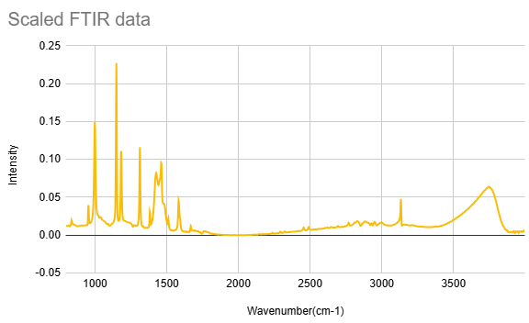
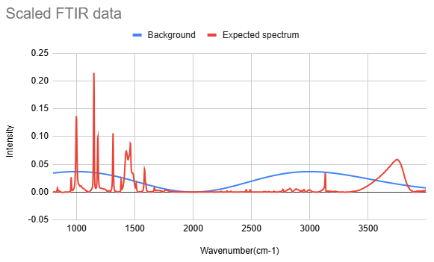
Numerical method
To understand how to remove substrate information we need to understand where it comes from and the factors that affect it.
Our background material will have some spectrum. And if we were looking only at it we would expect to see it in its full intensity. However due to the presence of our sample there will be some decrease in the relative intensity.
However we expect whatever this relationship is to be fixed. The presence of our sample won't change the relative spectrum of our substrate.
To say if our background has peaks [3,8] [5,6] and [10,20] and the intensity of the background in our sample is 50% we would expect the background to include the following [3,4] [5,3] and [10,10] they may be higher if the expected data has peaks at these values but we can predict the impact the background has.
This creates an equation for our data collected data = background*X + sample data which we can rewrite
Equation:
X = Collected Data - Expected Data
Background

Slide 11
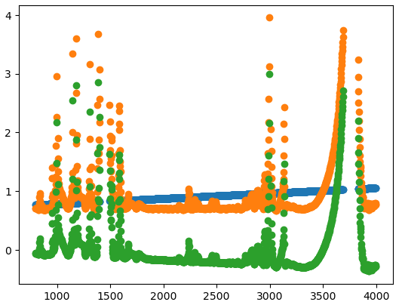
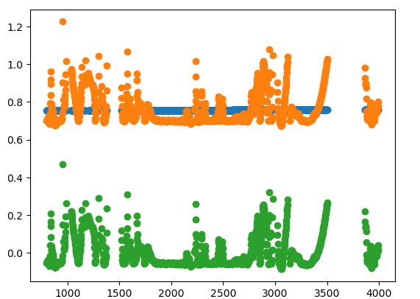
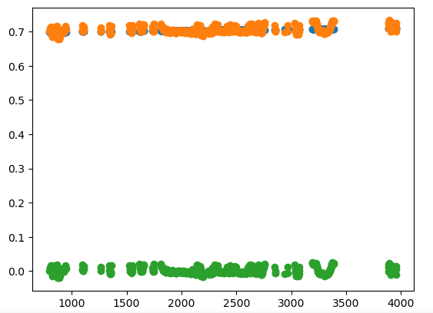
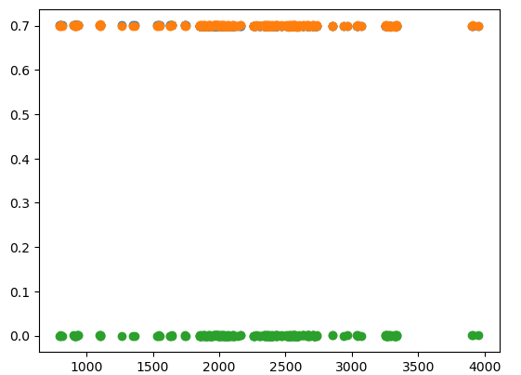
Numerical method - linear regression
Based on our equation for X which we expect to be a single value we can say what we expect from X. If we were to calculate X for every point we would expect to see a linear line. With a slope of 0 and an intercept equal to the scalar.
We can’t simply perform this fit since we don't have a sample dataset. But we can discuss the impact of this data through the lens of the equation: X = Collected Data/Background and how it differs from our original equation.
At points where our theoretical sample dataset is very high we would expect the value of our collected data to also rise.In this second case since the sample data isn't rising to compensate we would expect X to get much higher. But in areas where this expected data is low X should stabilize.
This opens up the opportunity for a linear regression. We can graph the equation X = Collected Data/Background and identify where it deviates from an ideal flat linear graph. Taking the highest deviating points since these are likely to be caused by the expected datas effect.
Using the linear regression function with our data we can identify the residuals or deviation from these values. Then remove the values with the largest residuals. By repeating this cycle of analysis and removal over and over we can slowly reduce the error. Excluding points which are likely to contain sample data until only the background portion of our collected data remains
We track this using Root mean squared error, comparing to a value we select for how much error is acceptable in the cases shown to the side the process was stopped at .9, .1 , .01 and .001

Slide 12
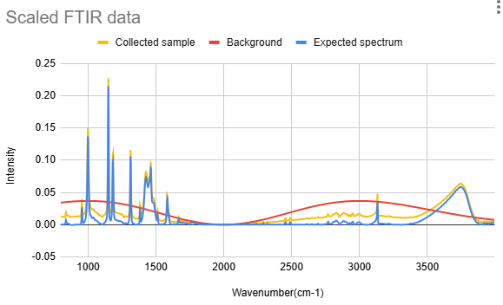
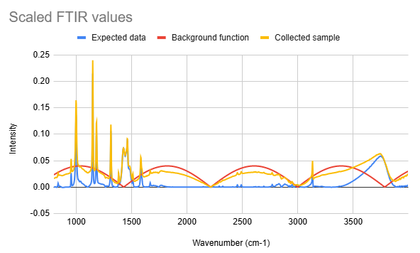
Methodology - sample backgrounds
Due to the timing of this project i was unable to collect finalized data on the various substrates being used. So instead added background functions into data in order to simulate various backgrounds.
Graph 1 uses the function =((x/1000-2)^2*e^(x/1000-2)^2)/10 and a scalar value of .35
Graph 1 uses the function =|sin((x-3000)/250))*0.04| and a scalar value of .7

Slide 13
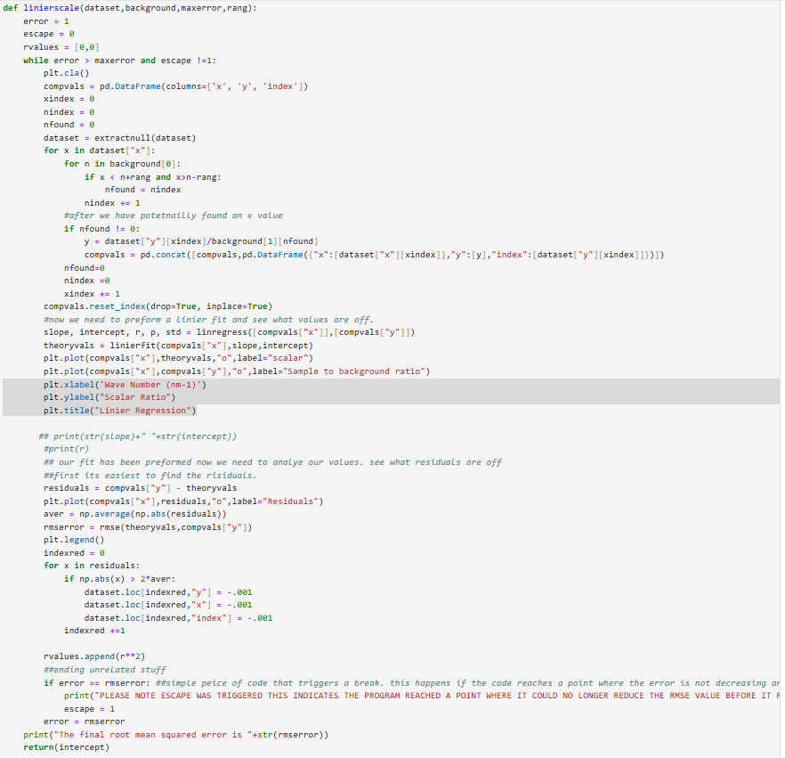
Code- Substrate Scaling
This is the code used for finding the scaler for substrate removal its built around a while loop which tracks the error of the function. In the first iteration this will be indicative the Root mean square error.
It removes entries from the data that are empty before copying the entries over to a set of comparison values. Then performing the linear fit creating a set of the data from the estimated slope

Slide 14
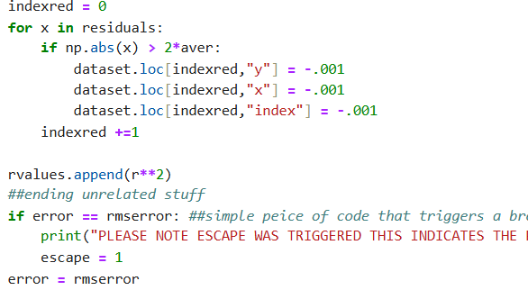
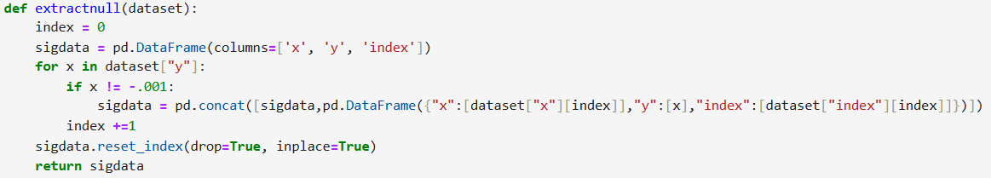
Code- Substrate Scaling
The second section of this code deals with the repeating step. As a parameter we are removing any values that are above twice the average residual. Over many runs this will eliminate the worst fitting data slowly resulting in a flat line we can extract the intercept from.

Slide 15
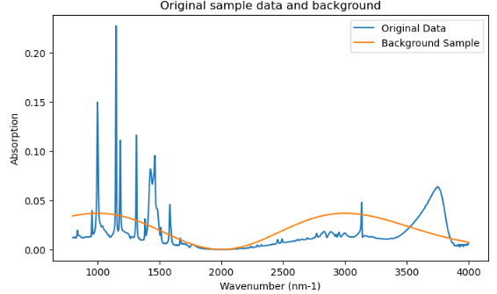
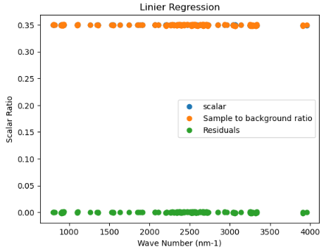
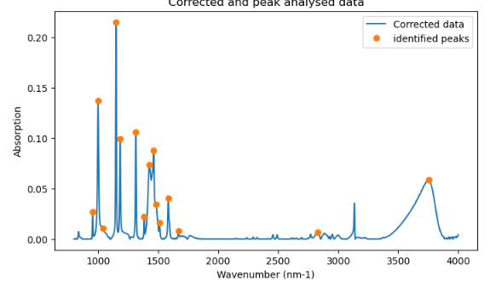
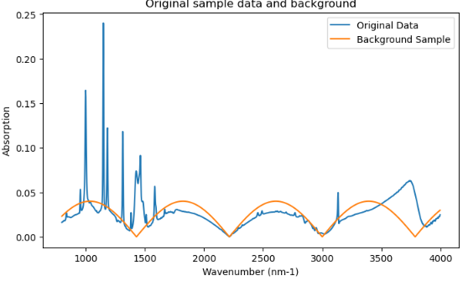
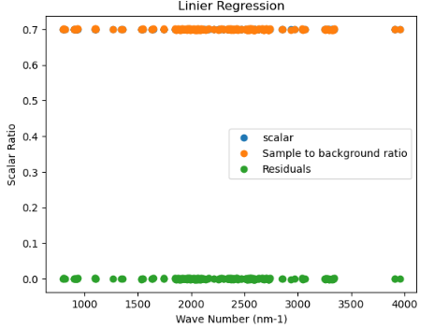
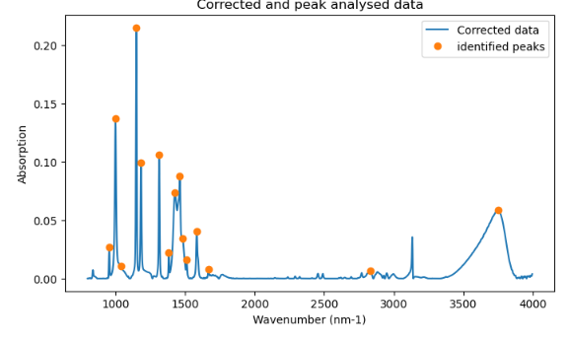
Results - Test 1 & 2

Slide 16
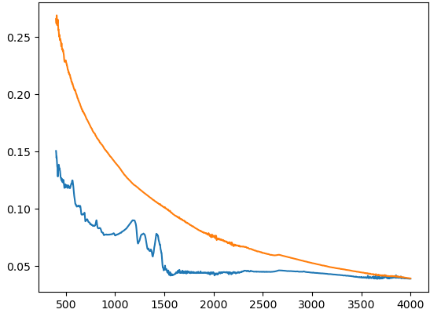
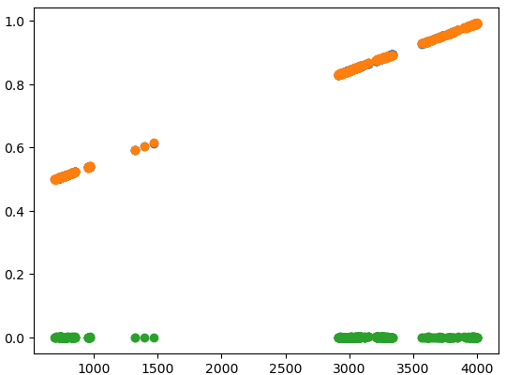
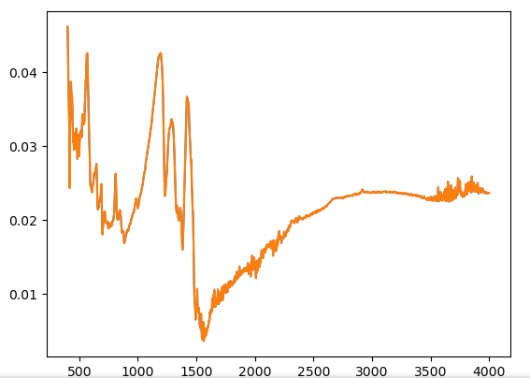
Results real data trial XRD of ZIF-8
The results of the real trial were slightly off. Our graph of X values winding up with a rather clear slope. Indicating some flaws in the methodology. However there is the potential that this value is an outlier caused by the arcing nature of the data.
You can note that the high slope seems to appear at the end where data converges. Since these areas have lower values they are far more likely to feel the effects of noise and random variance meaning its plausible this is throwing off the calculations. But still the translation dose create a more linear profile implying that with the correct parameters and tinkering a solution could be found.

Slide 17
Conclusions
Overall the preliminary results have been very promising, the linear fit has shown to be able to handle a wide variety of functions as made clear by the two tests. In a short period of time and with few input parameters.
Our real world data test is shaky but shows a somewhat effective leveling out of an extreme substrate curve.
In addition our modified data tests were successes in both cases the scaled solution being found despite high levels of noise. Showing the validity of this kind of linear regression for substrate removal.
This is promising for our research as it promises to allow the comparison of data across a variety of substrates allowing us to effectively compare a wide variety of samples and examine how different synthesis methods and substrates affect the final material

Slide 18
References
All test data was taken from IRRAS and XRD at The center for functional nanomaterials at brookhaven national laboratory either by myself or dennis lee.
Additional graphs for reference were used on the slides indicated below:
[2]Mashhadzadeh, A. H., Taghizadeh, A., Taghizadeh, M., Munir, M. T., Habibzadeh, S., Salmankhani, A., Stadler, F. J., & Saeb, M. R. (2020). Metal–Organic Framework (MOF) through the lens of molecular dynamics simulation: Current status and future perspective. Journal of Composites Science, 4(2), 75. https://doi.org/10.3390/jcs4020075
[4]Attwa, M., Said, A., ElGamal, M., El-Shaer, Y., & Elbasuney, S. (2023). Bespoke energetic zeolite imidazolate frameworks-8 (zif-8)/ammonium perchlorate nanocomposite: A novel reactive catalyzed high energy dense material with superior decomposition kinetics. Journal of Inorganic and Organometallic Polymers and Materials, 34(1), 387–400. https://doi.org/10.1007/s10904-023-02834-2
[6]Anastasiou, S., Bhoria, N., Pokhrel, J., & N. Karanikolos, G. (2016). Metal Organic Framework mixed matrix membranes for CO2 separation. Abu Dhabi International Petroleum Exhibition &amp; Conference. https://doi.org/10.2118/183264-ms

